Slide 1

NBA-Player-Analysis Including players starting their Careers from 1989-2021
Xiaoxuan Xiang

Slide 2
Research Purpose
This project can provide valuable insights to stakeholders in the NBA, sports betting and fantasy sports communities, helping them to make more informed decisions and to gain a competitive edge. For example, teams could use the data to identify players with good potential or to avoid selecting players who are unlikely to succeed in the NBA based on their early career statistics.
2. Interesting insight on League development, which would be beneficial to wider stakeholder groups to see the development trend and conduct further research.
Dataset:
NBA Draft Basketball Player Data 1989-2021: https://www.kaggle.com/datasets/mattop/nba-draft-basketball-player-data-19892021?select=nbaplayersdraft.csv
NBA Players Biometric, biographic and basic box score features from 1996 to 2021 season_https://www.kaggle.com/datasets/justinas/nba-players-data

Slide 3
Outline
Exploratory analysis
Top players
Top-draft-pick players comparison
International player trend
College and player
Unsupervised Machine Learning -Position clustering
Supervised Machine Learning - Potential to be a star player
Deployment

Slide 4
Exploratory Analysis

Slide 5
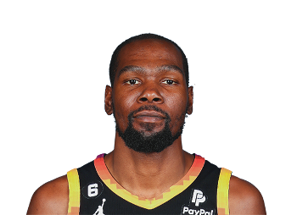
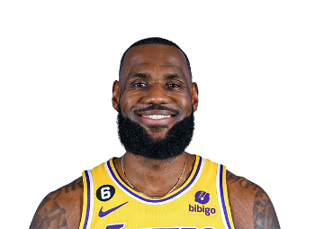
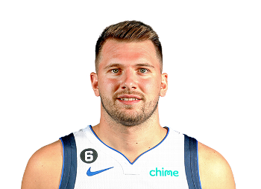
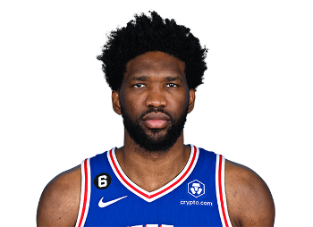
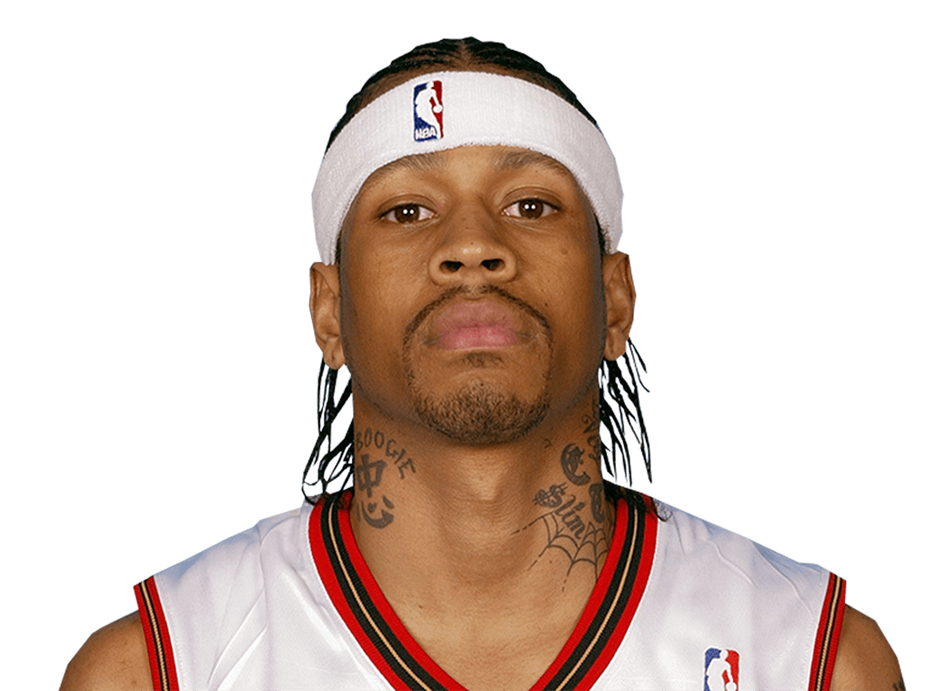
Top 5 Players-Greatest Finishing
Kevin Durant
LeBron James
Allen Iverson
Luka Dončić
Joel Embiid
*Based on the average points per game

Slide 6
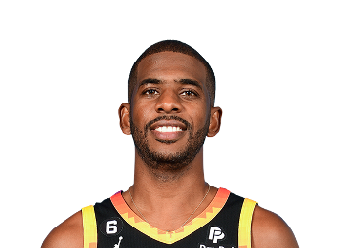
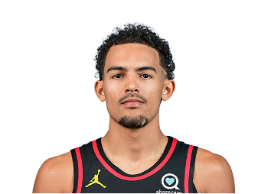
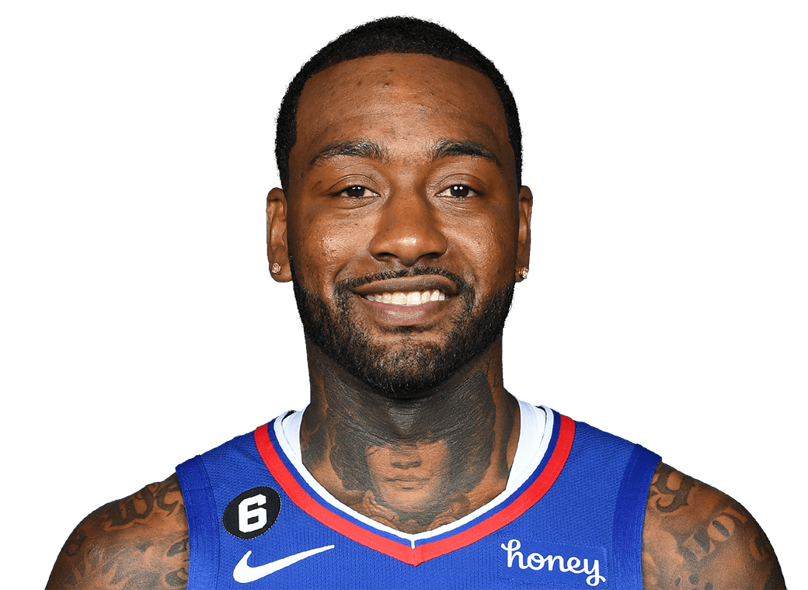
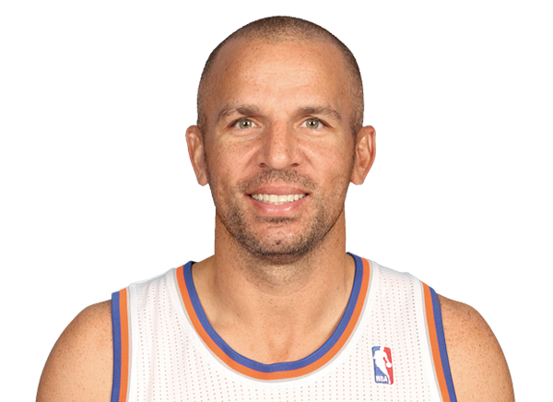
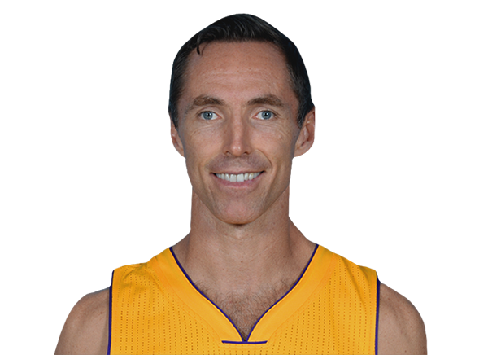
Top 5 Players-Greatest Play Making
Jason Kidd
Chris Paul
Trae Young
John Wall
Steve Nash
*Based on the average assists per game

Slide 7
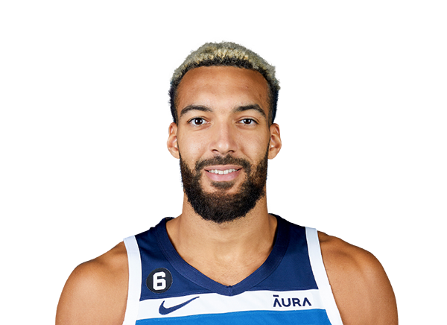
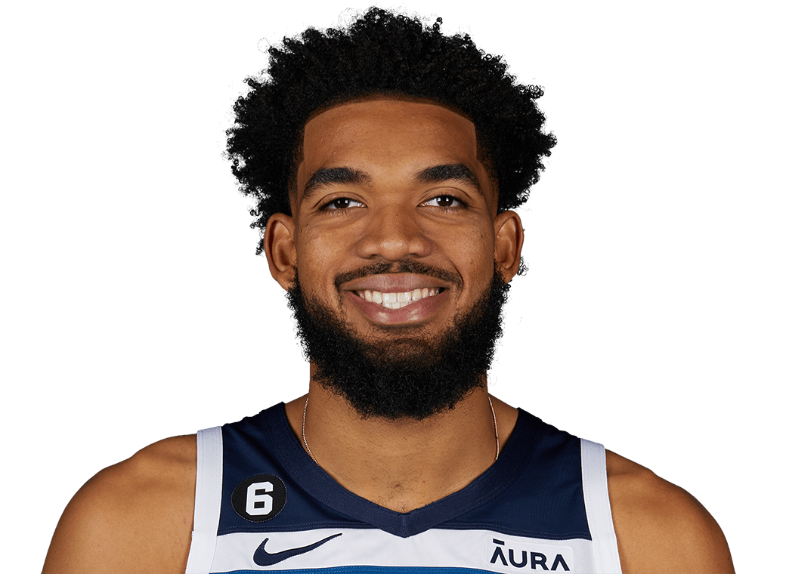
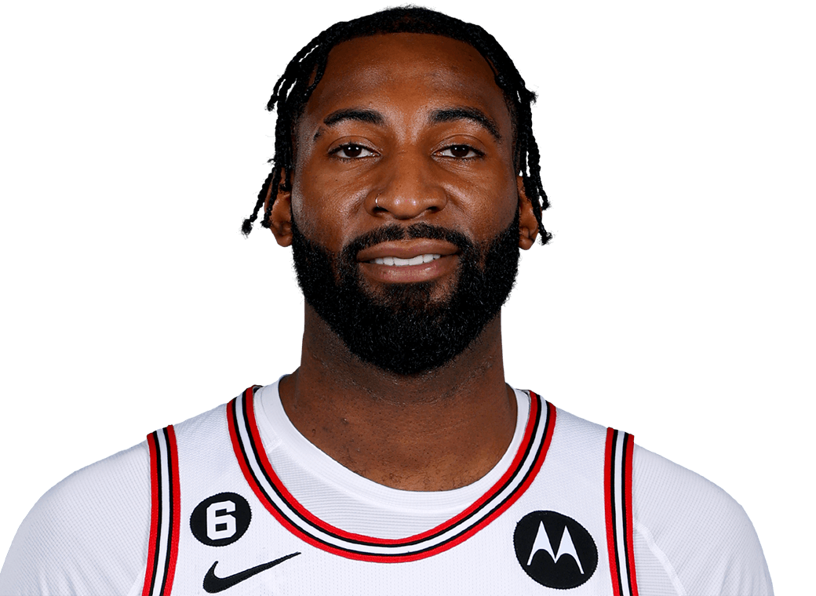
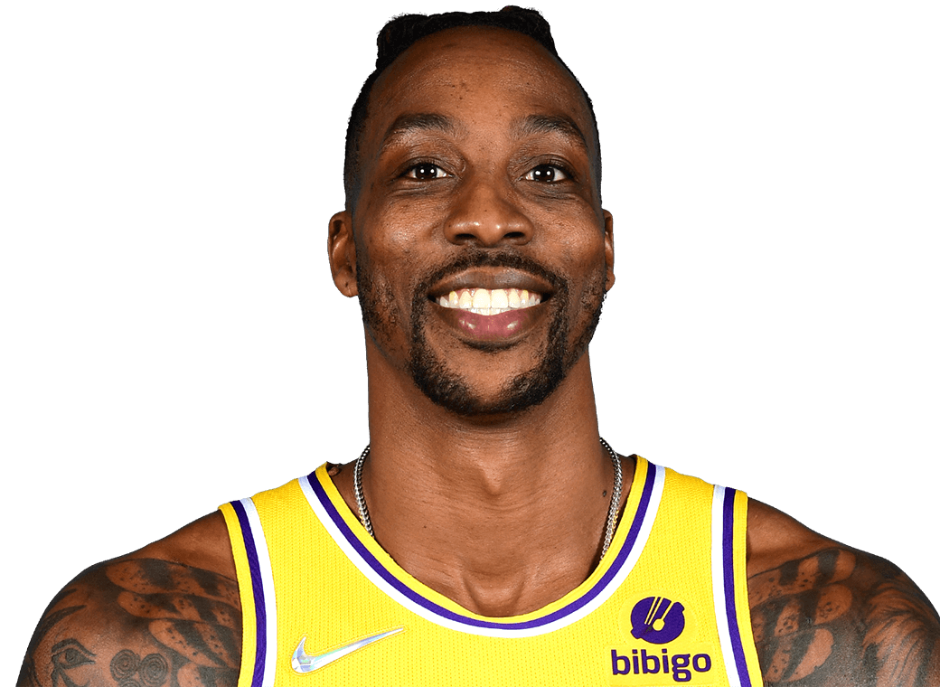
Top 5 Players-Greatest Rebound
Dwight Howard
Joel Embiid
Andre Drummond
Rudy Gobert
Karl-Anthony Towns
*Based on the average rebounds per game

Slide 8
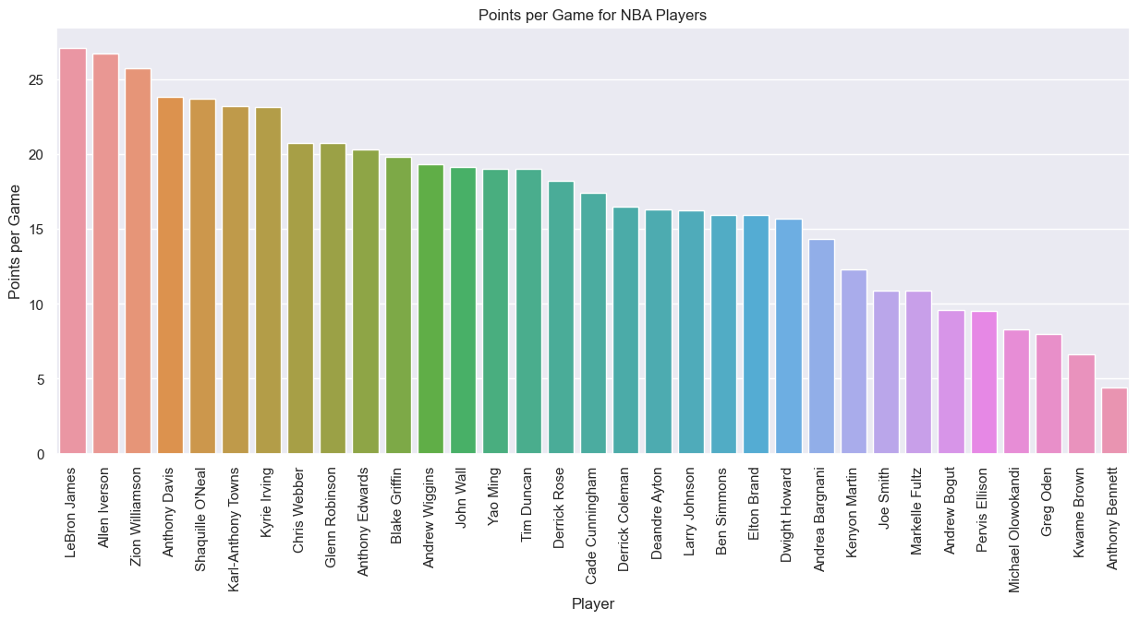
First-Draft-Pick Players Comparison

Slide 9
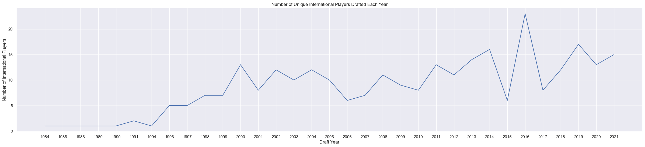
International Players Amount
The number of international players in NBA has shown an overall increase since the middle of the 90s.

Slide 10
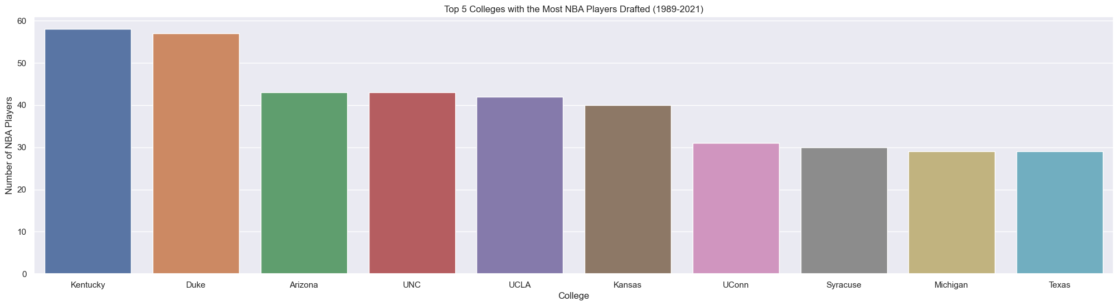
Players and Colleges
Top Five Colleges on Basketball:
Kentucky 58
Duke 57
Arizona 43
UNC 43
UCLA 42

Slide 11
Clustering Model Building

Slide 12
Unsupervised Machine Learning
Cluster players into 3 different positions in terms of their statistics. Use K-Mean algorithms to cluster similar players together based on their attributes and statistics on their early career to identify players’ types and positions (Guards, Forwards, Centers).
*early career: players’ stats of their first year in NBA.

Slide 13
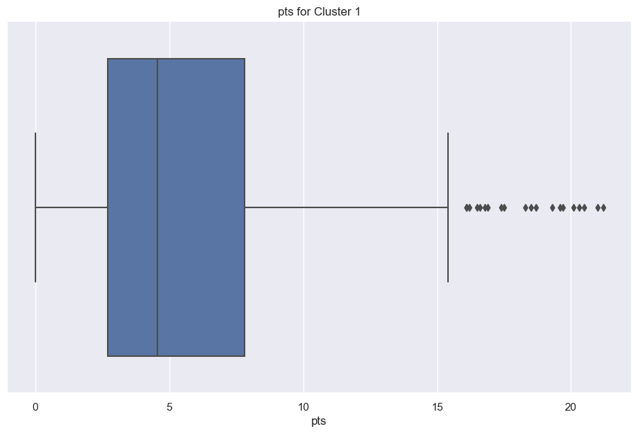
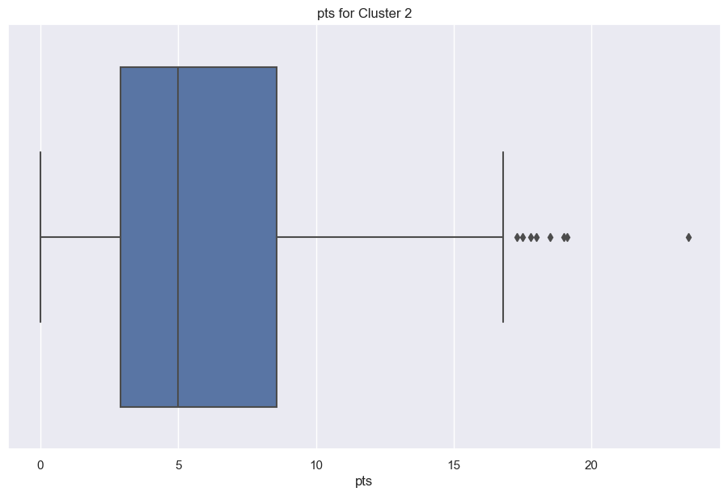
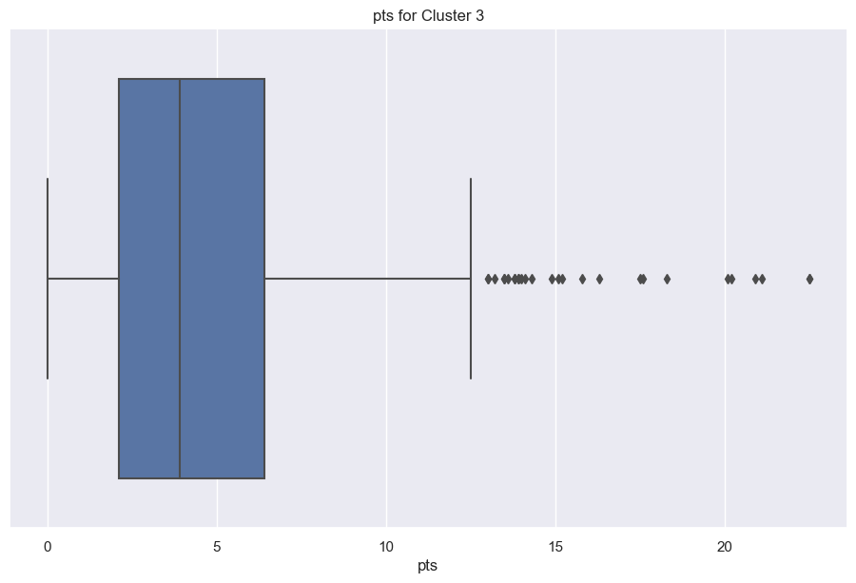
Average points in each group
Cluster2> Cluster1 >Cluster3

Slide 14
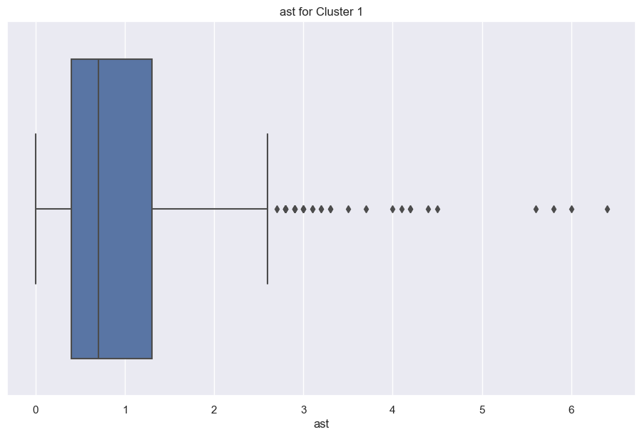
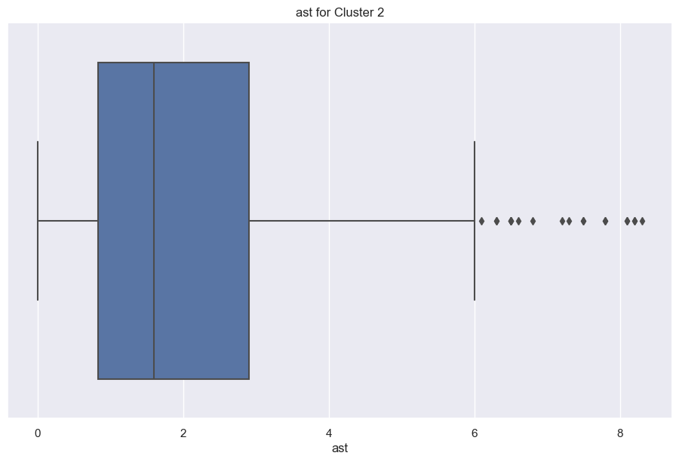
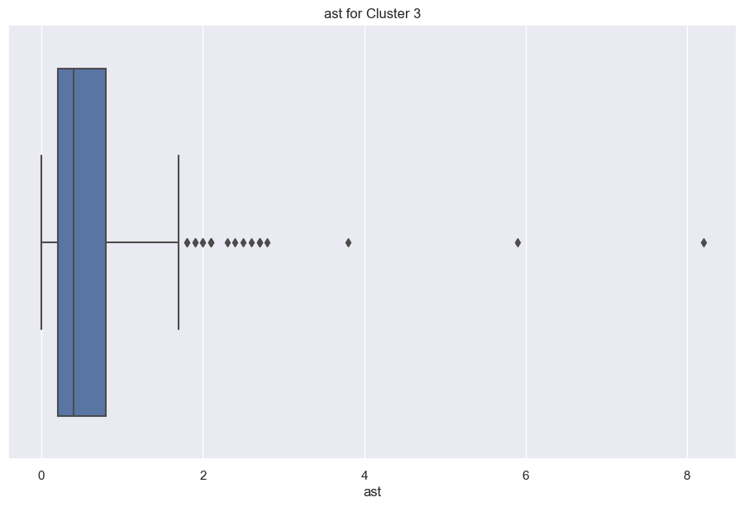
Average assists in each group
Cluster2> Cluster1 >Cluster3

Slide 15
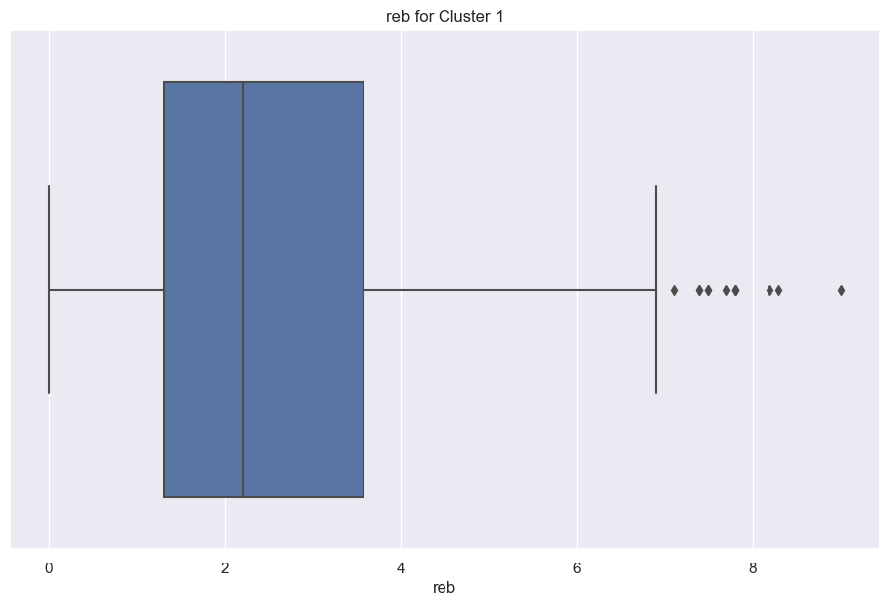
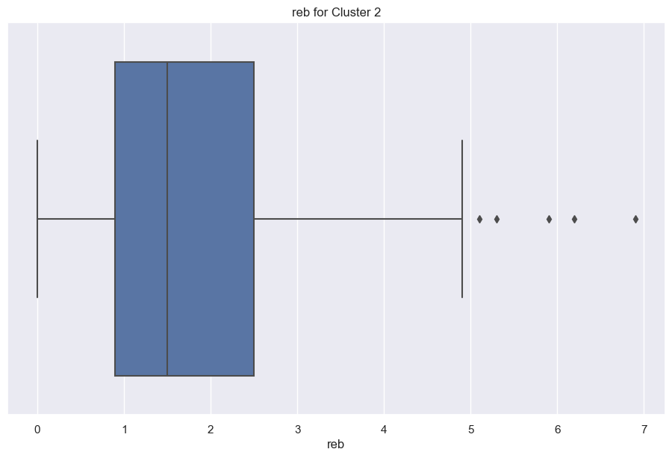

Average rebound in each group
Cluster3> Cluster2 >Cluster1

Slide 16
Unsupervised Machine Learning
According to the Above patterns:
Cluster1 is likely to be Foward
Cluster2 is likely to be Guard
Cluster3 is likely to be Center

Slide 17
Classification model building

Slide 18
Supervised Machine Learning
Predict if a player has potential to be a All-Star player or only a role palyer based on their statistics and attributes in early career.
*early career: players’ stats of their first year in the NBA
X= height, weight, average points, average assists, average rebounds stats of first year of players who have ever been selected to All-Star Game in their career.
y= Whether the players have been selected for All-Star Game (Binary).

Slide 19
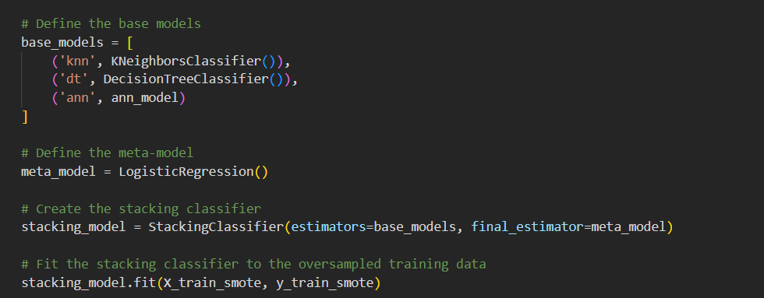
Supervised Machine Learning
! Imbalanced dataset
Only 50 All-Star Player in the dataset with over 1000 rows.
1. Oversample the minority class using SMOTE
2. Build up the stacking models with Knn, Decision tree and ann models.
Accuracy:0.8973105134474327

Slide 20
Deployment

Slide 21
Data Application Deployment
Deploy the above clustering and classification model through Streamlit. Users could input a player's weight, height, and stats in their early career and predict their tactic and commercial value in the future.

Slide 22
Thanks for listening

